Slide 1
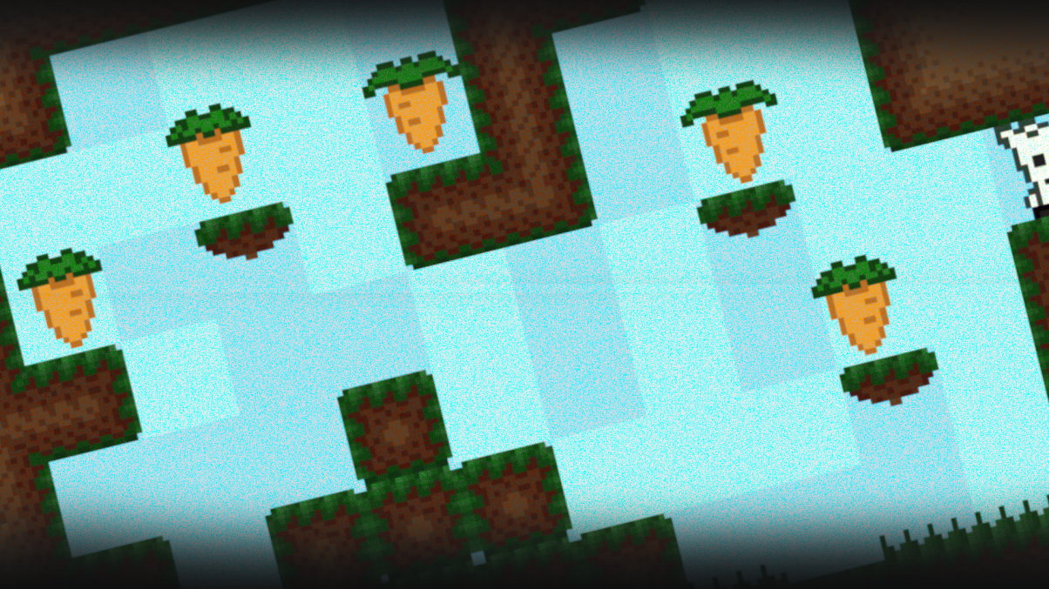

Rabbit Health
Jakub jagosz
Kamil Mędrala

Slide 2

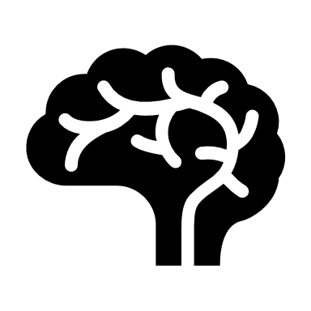

MAIN PRIORITIES OF THE PROJECT RABBIT HEALTH
Healthy food
Logical thinking
Skill

Slide 3

Conception Rabbit health
Our project is a motivation for people who are overweight or obese to various degrees and therefore their BMI level is quite high. We want potential players to feel that they are doing it for a purpose while picking fruit and vegetables scattered around the map. By collecting fruits and vegetables, the diet proposal is unlocked after passing a given level. Depending on the level, the player will have access to diets that may bring less results, to those that may bring very large results and require a lot of sacrifice. The diet will be related to the fruits and vegetables that are displayed for the duration of the board. The game is based on the principle: "The more the better." So, the higher the level, the better the diet proposal. We do not assume any drastic diets in our project. All proposals are checked by the highest-ranking nutritionists and are 100% safe.

Slide 4
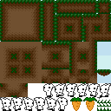
Rabbit Health - game rules
Bitmap – Rabbit Health
In this game, we play the role of a rabbit, whose task is to collect fruits or vegetables that we encounter while passing the board. After passing a given level, the proposed nutritional diet is unlocked, which can be used by a given player in real life. After encountering unhealthy food, for example entering a candy field, the player's penalty for entering this field is to return the rabbit to the starting field and re-enter the given board.

Slide 5
"CURIOSITY IS THE FIRST STEP TO HELL..."
You might be wondering what that saying has to do with this game, but we assure you that it adds a lot to it. Well, people talk about curiosity that it is the first step to hell, although we also focused on curiosity in this game. We think that many people would like to play this game out of curiosity, because despite the fact that they may know some diets, they would like to see our slimming proposals, and these are proven methods and recommended by many reputable dieticians. We believe that this feature will also encourage potential players to try their hand at this game and possibly see how the game ends. It is curiosity in our project that is such a hidden priority.

Slide 6
Information about the construction of the game
The engine uses a simple bitmap, which is attached above in the rules of the game. The bitmap itself is described in JavaScript, i.e. board entrance, artifacts, grass, etc.
The drawing is done with the Canvas element, which was first used in HTML5.
The game is written in JavaScript and hosted on which it is specially styled in cascading style sheets.
The game is designed for the PC platform.
It is planned to develop the game further by adding new boards as well as more creative diets.
The game is recommended for users over 12 years of age.
The game is created in two-dimensional graphics, i.e. in 2D.

Slide 7
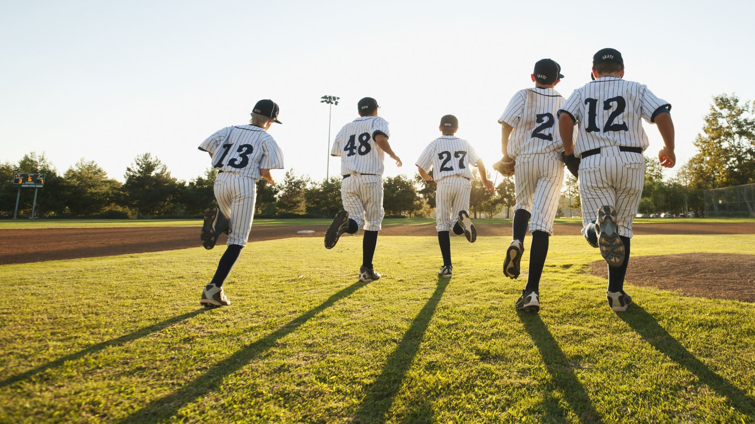
FURTHER ASSUMPTIONS FOR RABBIT HEALTH
Thanks to this innovative project, we want to motivate players to lose weight in safe and proven methods. With the passage of a given level of the game, there will be more and more ways to lose weight, for example, after passing the first board, a diet appears that does not require much sacrifice and can bring much less effects, and after passing the next levels, more advanced methods of losing weight appear. The slimming methods presented will be from the cheapest to the most expensive.
We are people who value a relatively healthy lifestyle and thanks to such a game we believe that more people will start to make order with each other, and thus they can extend their lives by several years. Thanks to the combination of a logical and arcade game with ways to lose weight, we believe that this game will motivate, improve logical thinking and the reflexes of a given player. Thanks to this innovative project, we want to motivate players to lose weight in safe and proven methods. With the passage of a given level of the game, there will be more and more ways to lose weight, for example, after passing the first board, a diet appears that does not require much sacrifice and can bring much less effects, and after passing the next levels, more advanced methods of losing weight appear. The slimming methods presented will be from the cheapest to the most expensive.
We are people who value a relatively healthy lifestyle and thanks to such a game we believe that more people will start to make order with each other, and thus they can extend their lives by several years. Thanks to the combination of a logical and arcade game with ways to lose weight, we believe that this game will motivate, improve logical thinking and the reflexes of a given player.

Slide 8

DIETS USED IN RABBIT HEALTH

Slide 9
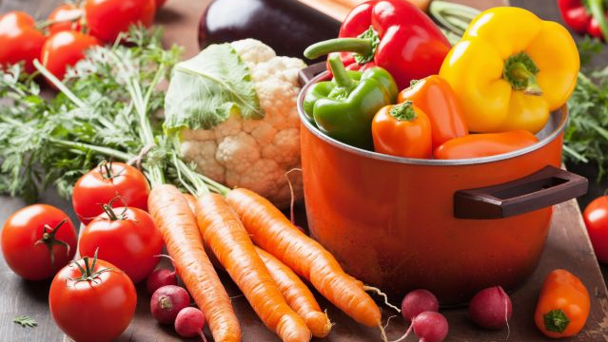
multi-vegetable diet
We want to present the main aspects of this diet, namely:
should be arranged in such a way that 3 or 4 meals based on vegetables dominate during the day,
the daily limit may not exceed 1500 Kcal,
In this diet, you should eat the following vegetables: spinach, tomato, lettuce, cucumber, beans, this diet lasts for two weeks.
More information on this solution can be found at: LINK

Slide 10
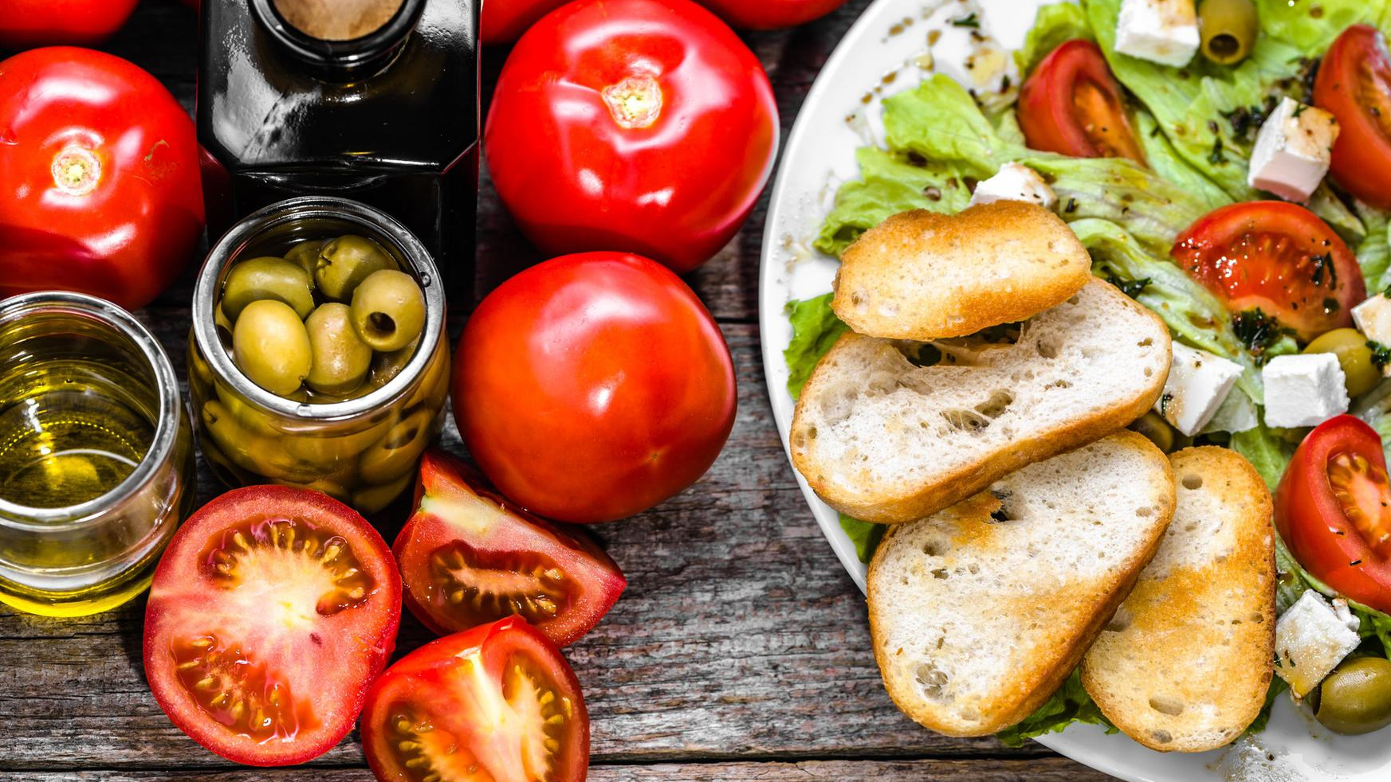
MEDITERRANEAN DIET
Eat foods high in healthy fats, for example: olive oil, fish,
Limit your consumption of poultry, eggs, and red meat.
More information on this solution can be found at: LINK

Slide 11
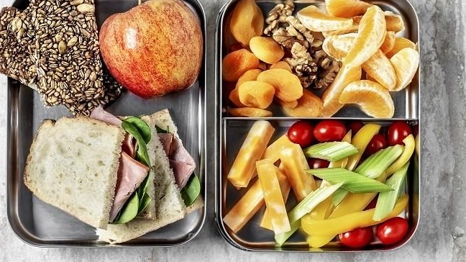
SIRTFOOD DIET
According to the authors of the diet, its key principle is not what to get rid of from the menu, but what products to include. The basis of the sirtfood diet are vegetables, fruits, spices and nuts rich in polyphenols,
It lasts 15 days and consists of 3 stages.
More information on this solution can be found at: LINK

Slide 12
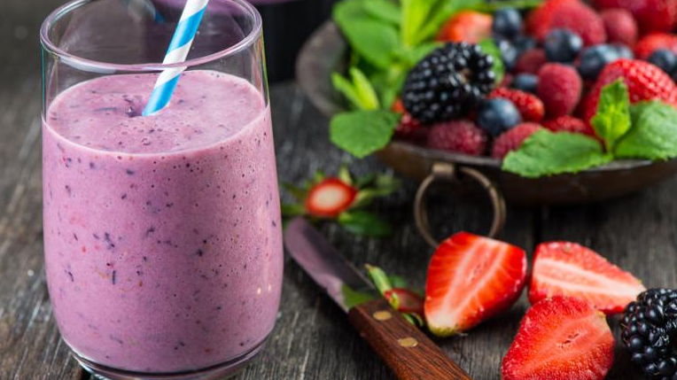
COCKTAIL DIET
During this diet, follow these rules:
Add cold-pressed oils, e.g. rapeseed, linseed, to salads and vegetable cocktails. The Omega-3 acids contained in them perfectly neutralize toxins and cleanse the blood vessels,
Before each meal, drink a glass of smoothie. It is prepared every morning and divided into portions.
More information on this solution can be found at: LINK

Slide 13
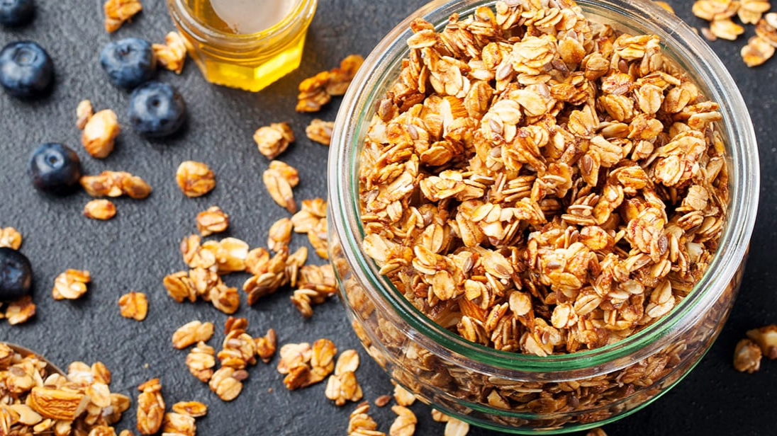
FIBER DIET
Dr. Siegal's high-fiber diet consists of eating plenty of vegetables, fruits and whole grains, which are foods that contain large amounts of fiber. It is a diet that eliminates calories, but also does not make you feel hungry. Regulates the metabolism. What are the principles of a fiber diet.
The following rules should be followed:
-15-20 g of cooked green vegetables,
-15-20 g of fresh raw vegetables,
-one large or two small fruits.
More information on this solution can be found at: LINK

Slide 14
Basic concepts
JavaScript - a programming language that enables the implementation of complex elements on the website, thanks to which the website can not only display static information, but also handle changing the content according to the situation, display interactive maps and animations of 2D / 3D graphics, display video, etc. This is the third layer standard web technologies from HTML and CSS.
Cascading Style Sheets (CSS) – language used to describe the form of presentation of WWW pages. CSS was developed by the W3C in 1996 as a descendant of DSSSL for use in conjunction with SGML. The first draft of the CSS was proposed in 1994 by Håkon Wium Lie.
HTML5 Canvas (Canvas element) - an HTML language element introduced in HTML 5 that allows for dynamic script rendering of shapes and bitmap images. Thanks to the introduction of the canvas object, it was possible to create dynamic two- and three-dimensional animations or games running in browsers without additional plugins.

Slide 15
The end

